Slide 1
Stitchable Neural Networks
Presenter: Longfei Ma
2023.6.15
Pan Z, Cai J, Zhuang B. Stitchable Neural Networks[C]//Proceedings of the IEEE/CVF Conference on Computer Vision and Pattern Recognition. 2023: 16102-16112.
https://snnet.github.io/

Slide 2
Contents
Background and Challenges
Proposed Method
Experimental Results
Pan Z, Cai J, Zhuang B. Stitchable Neural Networks[C]//Proceedings of the IEEE/CVF Conference on Computer Vision and Pattern Recognition. 2023: 16102-16112.
https://snnet.github.io/

Slide 3
Contents
Background and Challenges
Proposed Method
Experimental Results
Pan Z, Cai J, Zhuang B. Stitchable Neural Networks[C]//Proceedings of the IEEE/CVF Conference on Computer Vision and Pattern Recognition. 2023: 16102-16112.
https://snnet.github.io/

Slide 4
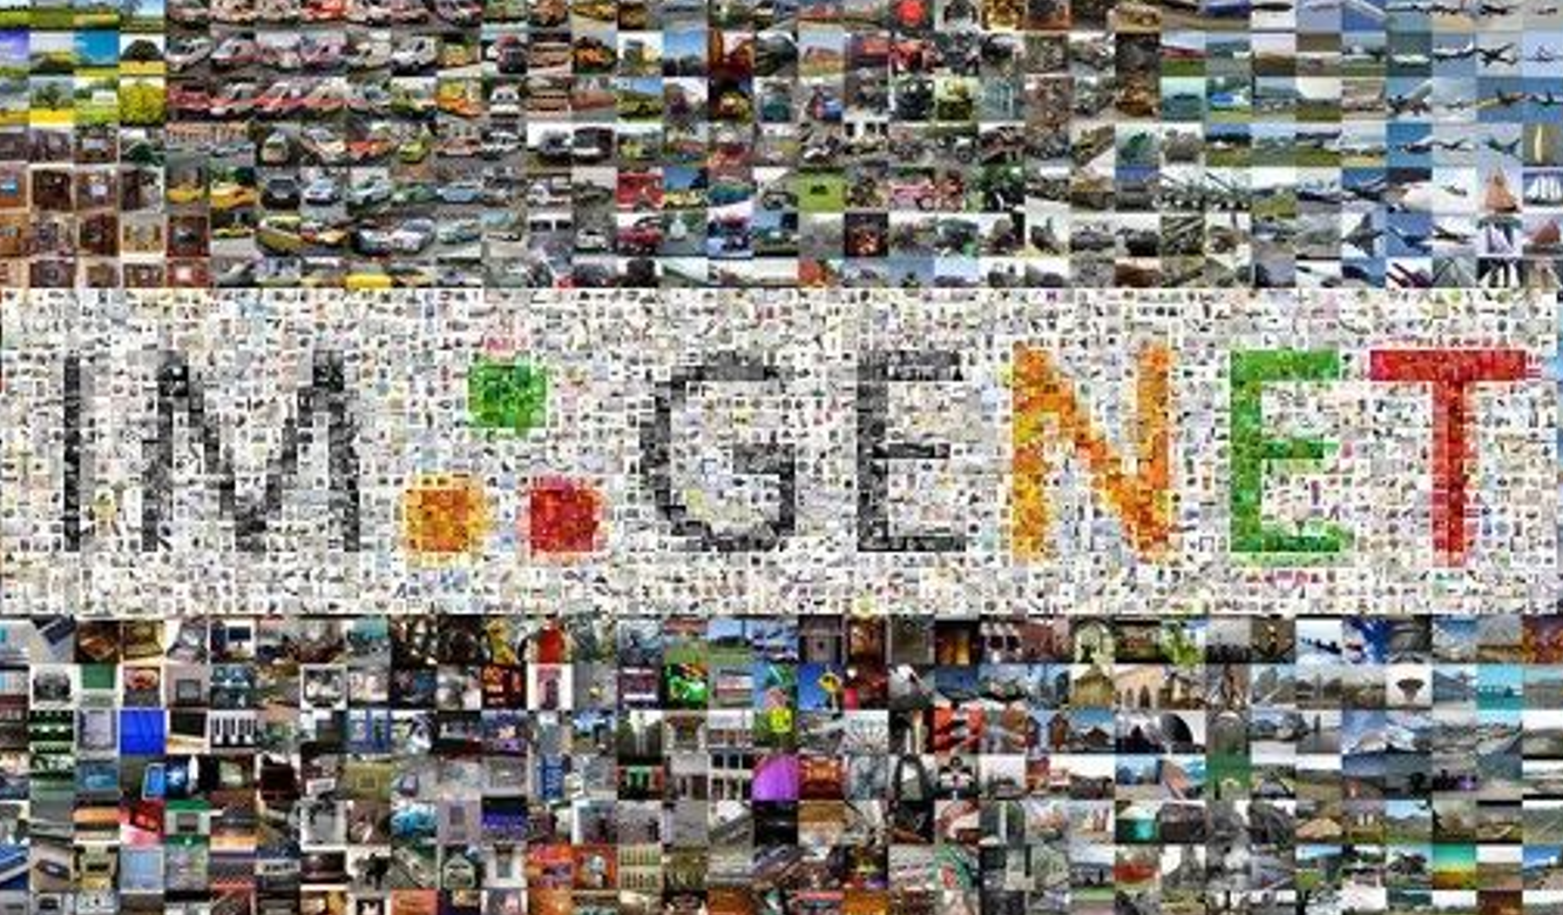
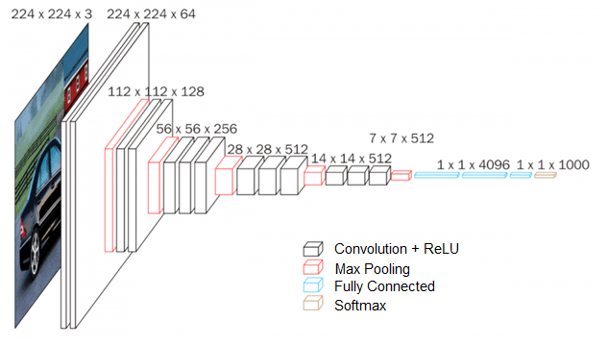
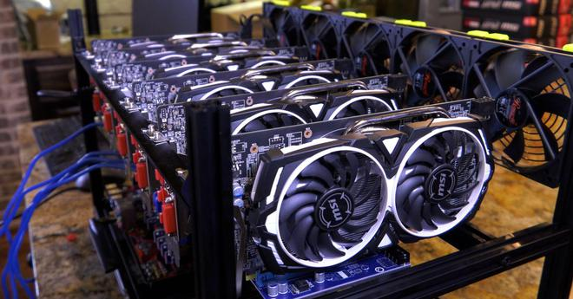
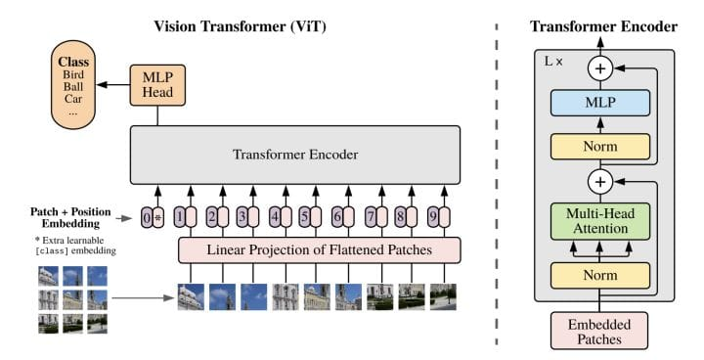
Pytorch image models (Timm)
https://github.com/rwightman/pytorch-image-models
800+ models
Massive Data & Computing Resources
Rapid Development of Deep Learning
Model Zoo
Transformers: State-of-the-art natural language processing (HuggingFace)
https://huggingface.co/transformers/
81k+ models
Pan Z, Cai J, Zhuang B. Stitchable Neural Networks[C]//Proceedings of the IEEE/CVF Conference on Computer Vision and Pattern Recognition. 2023: 16102-16112.
https://snnet.github.io/
Notes:
近些年，大规模数据集的涌现和算力的大幅提升推动了深度学习的飞速发展。目前，研究人员们已经构建了大量高性能的神经网络架构，这些大量的模型构成了神经网络模型库，或者称之为“Model Zoo”。这里给出了两个主流的模型库，分别是pytorch中的Timm模型库，包含超过800个预训练模型，以及基于Transformer架构的HuggingFace模型库，包含超过8万个预训练模型。

Slide 5
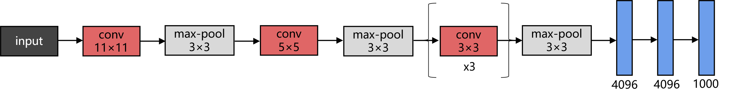
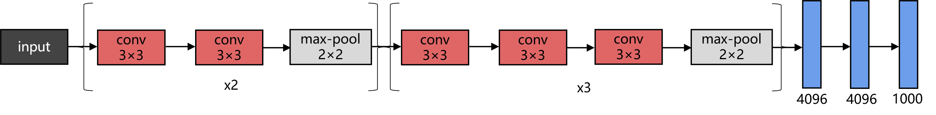
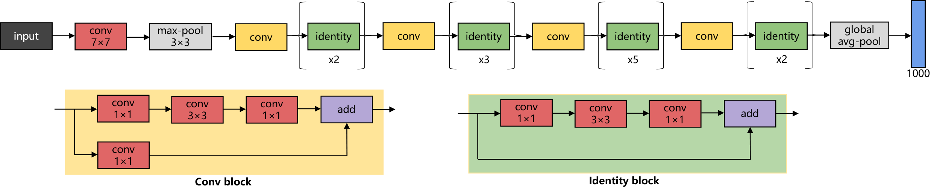
Classical Neural Networks
Params: 62M
FLOPs: 720M
AlexNet
Params: 138M
FLOPs: 15G
VGG-16
Params: 25M
FLOPs: 3.86G
ResNet-50
Fixed computational graph cannot adapt to different resource constraints (e.g., energy, latency, on-chip memory)
Pan Z, Cai J, Zhuang B. Stitchable Neural Networks[C]//Proceedings of the IEEE/CVF Conference on Computer Vision and Pattern Recognition. 2023: 16102-16112.
https://snnet.github.io/
Notes:
尽管有了这些模型库，我们可以轻松地获得大量经过预训练的高性能神经网络，但是在部署应用时的灵活性仍然受到限制。这里给出了几种经典的CNN模型架构，可以看出虽然这些模型都经过了精心地设计，在图像任务上具有优异的性能，但是它们的参数量、推理时的运算量是不同的，并且推理精度也有所差异，由于这些模型都使用了固定的计算图，因而无法自适应不同的资源约束，比如能耗、时延、内存等。

Slide 6
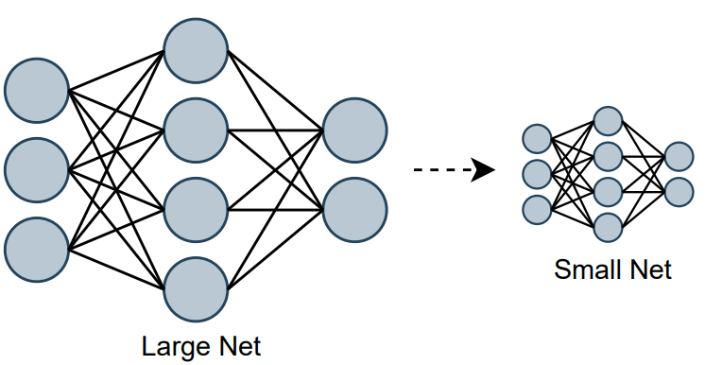
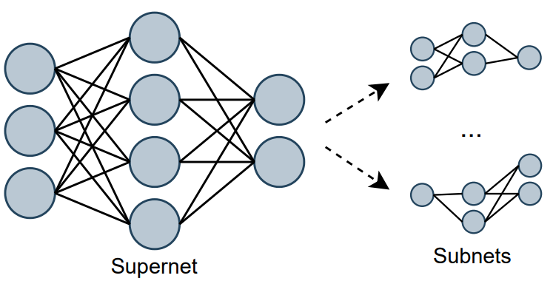
Existing Deep Learning Technologies
Network Compression
(One-to-One)
Neural Architecture Search
(One-to-Many)
Obtain a single small model
Only target one specific resource budget
Support many sub-networks
Training is very time consuming and computationally expensive
Limited to a single model design space, difficult to inherit rich knowledge from pre-trained model families
Pan Z, Cai J, Zhuang B. Stitchable Neural Networks[C]//Proceedings of the IEEE/CVF Conference on Computer Vision and Pattern Recognition. 2023: 16102-16112.
https://snnet.github.io/
Notes:
为了解决这个问题，现有的深度学习技术主要有两大类。一类是网络压缩，例如剪枝、知识蒸馏等，这类方法的目标是利用训练好的大规模模型来获得一个高性能的小模型，但是这种方法只针对与特定的资源约束，无法适应动态的部署环境。第二类技术是神经架构搜索，目标是在训练一个强大的超级网络，这个超级网络可以支持大量子网络的推理，但训练超级网络非常耗时且计算成本高昂。现有的这些方案都局限于单一的模型设计空间，无法从预训练模型库中继承丰富的知识。

Slide 7
Contents
Background and Challenges
Proposed Method
Experimental Results
Pan Z, Cai J, Zhuang B. Stitchable Neural Networks[C]//Proceedings of the IEEE/CVF Conference on Computer Vision and Pattern Recognition. 2023: 16102-16112.
https://snnet.github.io/
Notes:
下面介绍这篇文献所提出的可缝合神经网络的方案。

Slide 8
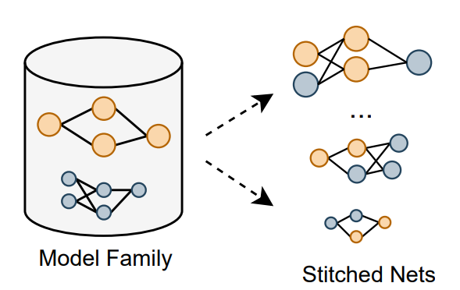
Proposed Stitchable Neural Network
Stitchable Neural Networks
(Many-to-Many)
Stitches off-the-shelf pretrained models
Covers a fine-grained level of model complexity/performance for a wide range of deployment scenarios
Training is quick and computationally cheap
Pan Z, Cai J, Zhuang B. Stitchable Neural Networks[C]//Proceedings of the IEEE/CVF Conference on Computer Vision and Pattern Recognition. 2023: 16102-16112.
https://snnet.github.io/
Notes:
首先概况一下可缝合神经网络的思想和优势，该方法是利用模型族中的大量预训练好的网络模型，缝合出若干新的网络模型。该方案可以覆盖细粒度的模型复杂性/性能，从而适应广泛的部署场景，并且训练非常快速，计算成本低廉。

Slide 9

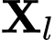
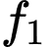
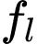
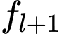
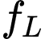
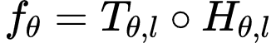
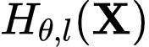
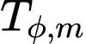

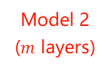
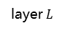
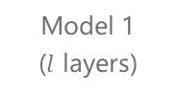
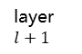
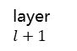
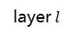
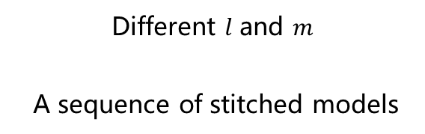
Preliminaries of Model Stitching
Single pre-trained model
input
layer 1
…
layer $l$
layer $l+1$
…
layer $L$
output
New stitched model
Different $l$ and $m$
A sequence of stitched models
input
layer 1
…
layer $l$
layer $l+1$
…
layer $L$
output
stitching
layer
Model 1
($l$ layers)
Model 2
($m$ layers)
Pan Z, Cai J, Zhuang B. Stitchable Neural Networks[C]//Proceedings of the IEEE/CVF Conference on Computer Vision and Pattern Recognition. 2023: 16102-16112.
https://snnet.github.io/
Notes:
下面介绍一下缝合网络的符号表示。

Slide 10
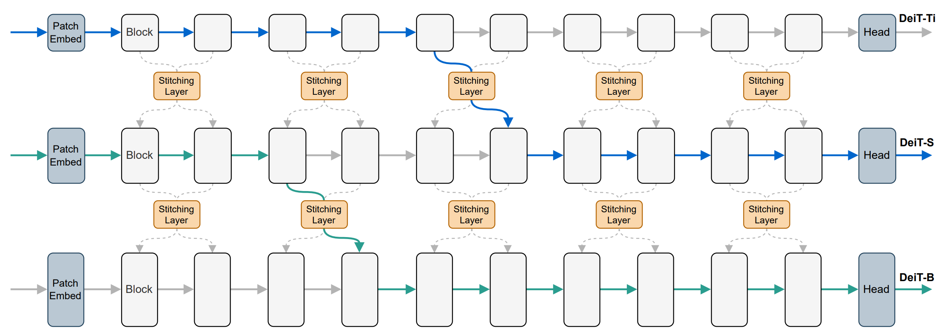
Examples of Stitchable Networks
Stitchable Neural Network obtained by pre-trained variants of DeiTs
Pre-trained models to be stitched: anchors
Derived models by stitching anchors: stitches (Distinguish by color)
Pan Z, Cai J, Zhuang B. Stitchable Neural Networks[C]//Proceedings of the IEEE/CVF Conference on Computer Vision and Pattern Recognition. 2023: 16102-16112.
https://snnet.github.io/
Notes:
这里给出了一个利用DeiT模型族进行网络缝合的例子，DeiT是一类vision transformer模型。这篇文章把用来进行缝合的预训练模型称为anchor，把缝合出的新模型成为stitch。通过改变执行路径可以得到不同的缝合网络。图中的

Slide 11
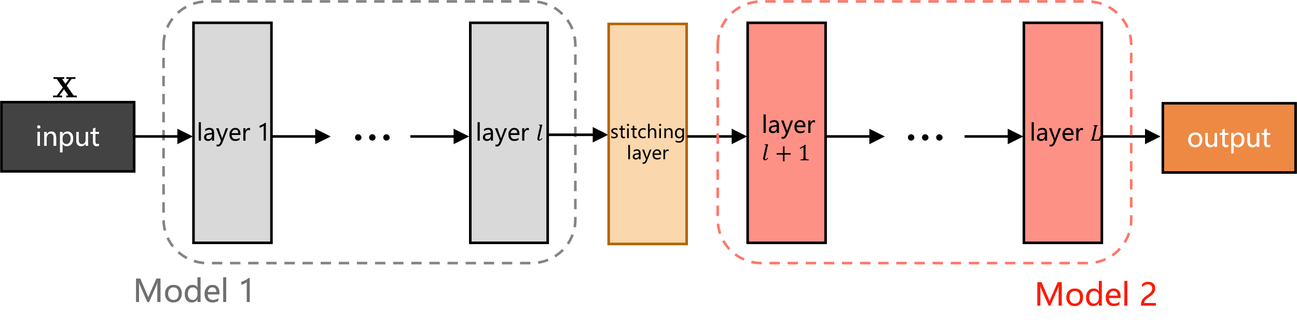
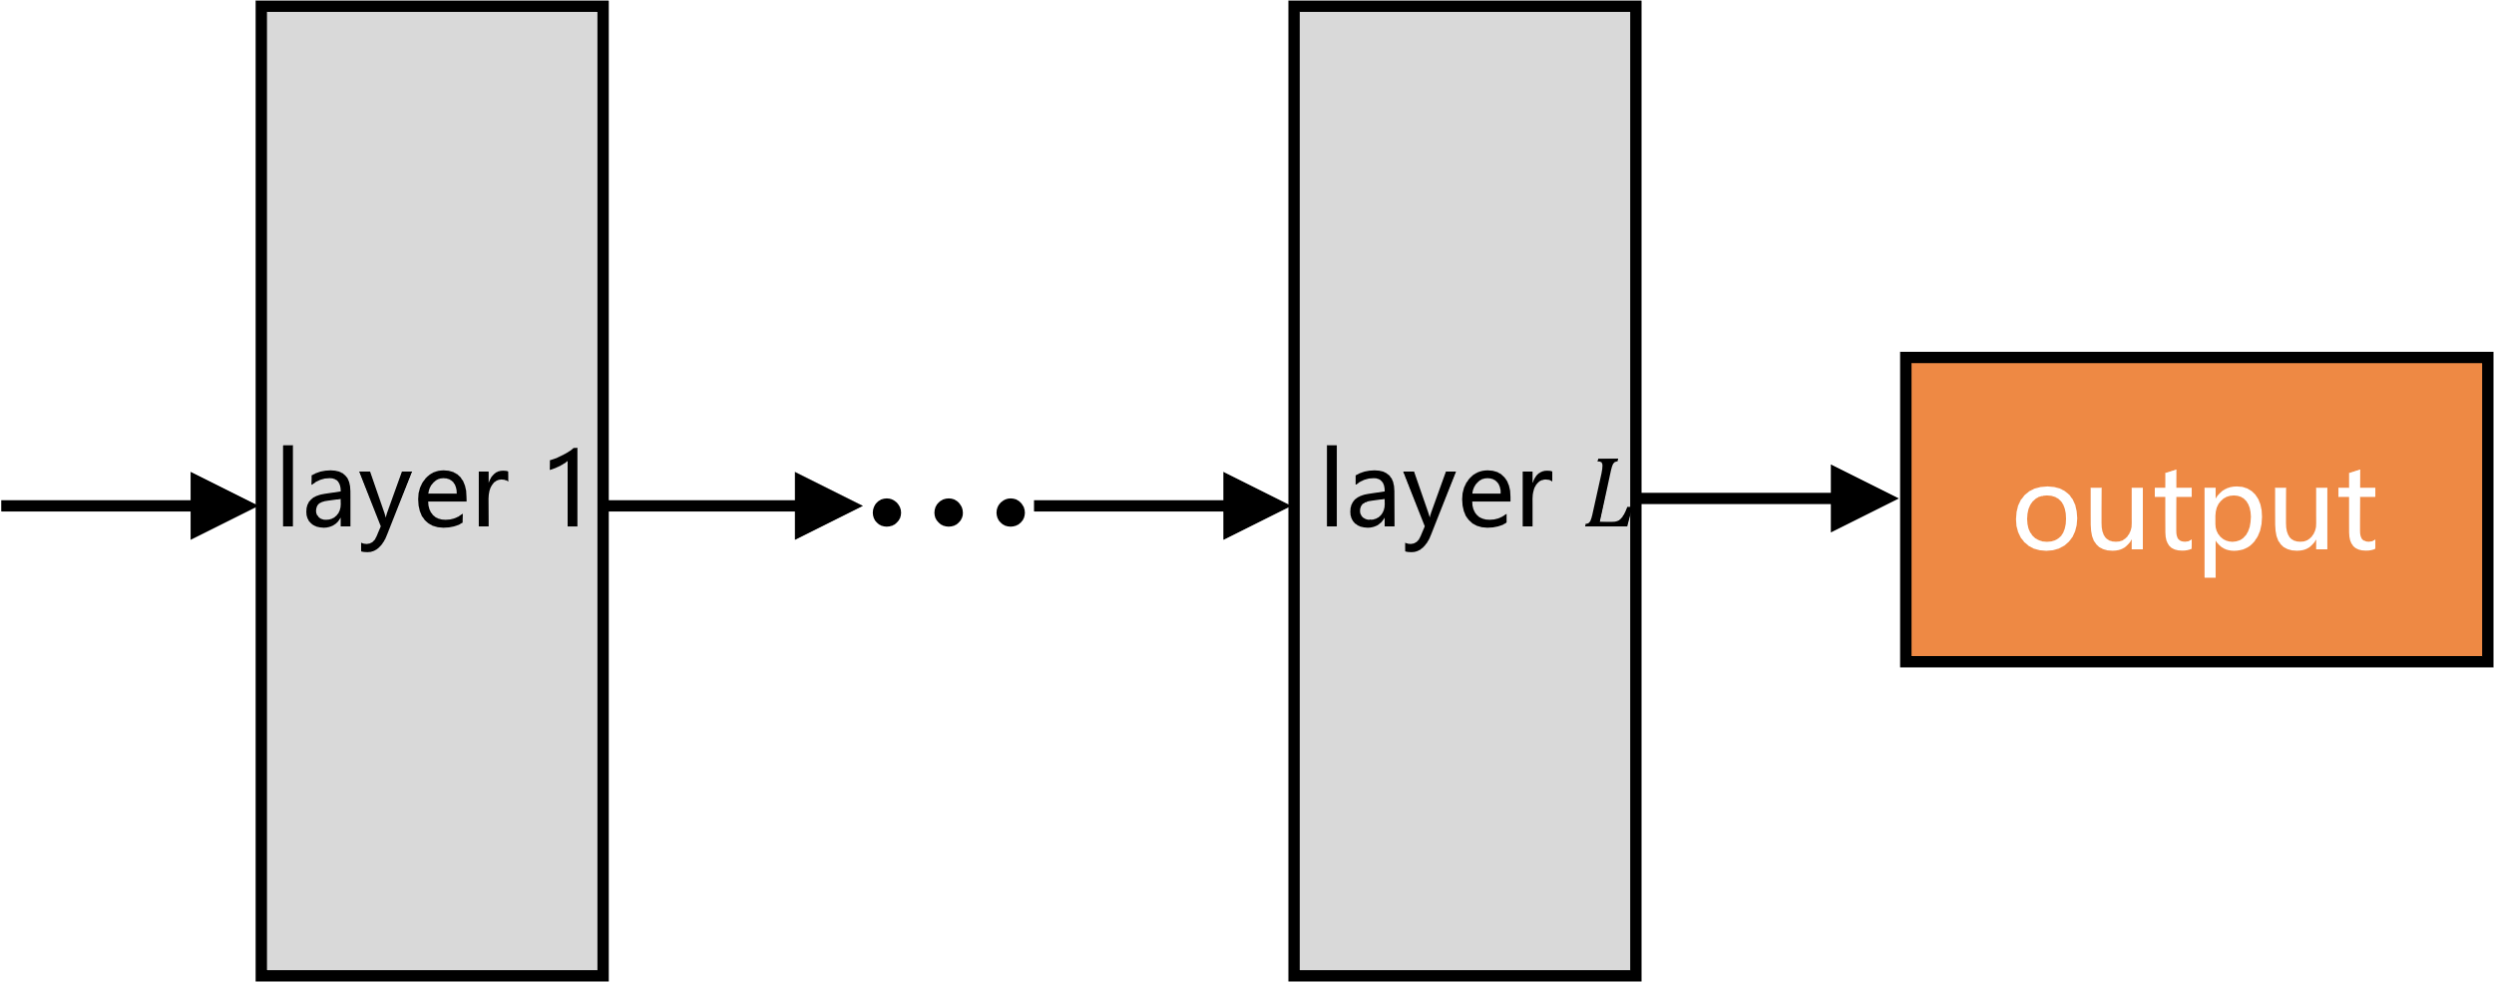
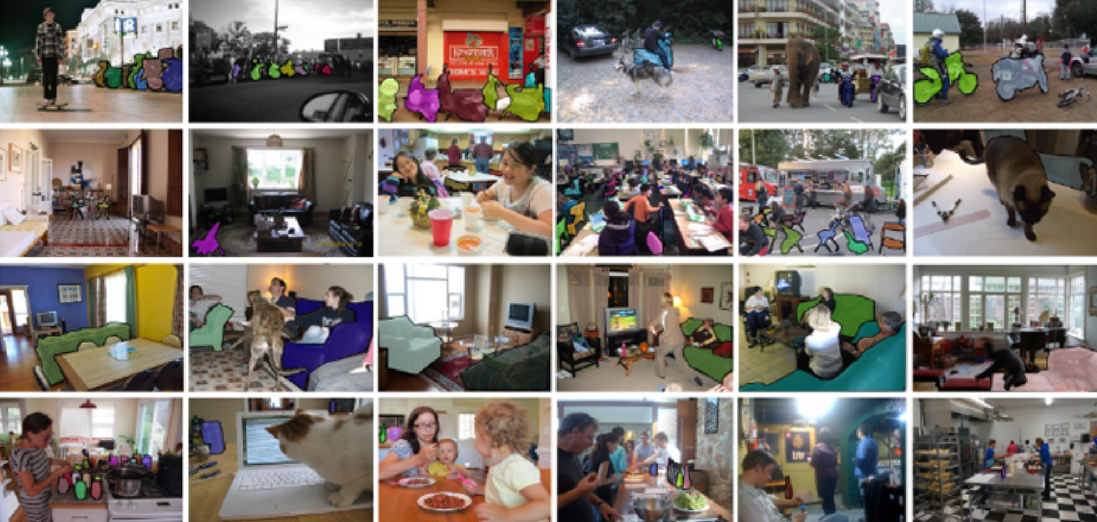
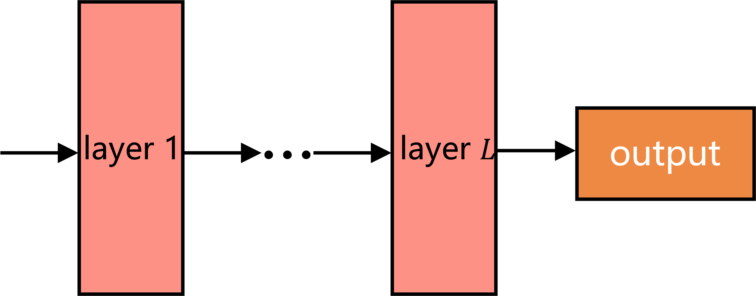
Stitching Method
What to stitch: The large distribution gap of different domains makes it difficult for the splicing layer to learn the transition, so the selected anchor points should have the same domain for pre-training.
X
√
Different pre-training domains
Same pre-training domain
COCO
Pan Z, Cai J, Zhuang B. Stitchable Neural Networks[C]//Proceedings of the IEEE/CVF Conference on Computer Vision and Pattern Recognition. 2023: 16102-16112.
https://snnet.github.io/
Notes:
下面具体地讲一下缝合方式。首先是锚点的选择。由于不同预训练领域的分布差距较大，使得拼接层难以学习到过渡关系，所以选择的锚点应具有相同的领域进行预训练。不仅预训练域的任务要一直，所用数据集也应该一直。因此这篇文献所用的模型都在imagenet数据集上进行训练。

Slide 12

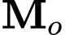
Stitching Method
How to stitch: The stitching layer should be as simple as possible because its purpose is not to improve the model performance but to map the transformed features, so the 1×1 convolutional layer is used as the stitching layer.
Conv 1×1
The anchors have been pre-trained, so the transformation matrix can be obtained by solving the following problem
The optimal solution can be expressed as
is easy to obtain but the performance is not stable
Pan Z, Cai J, Zhuang B. Stitchable Neural Networks[C]//Proceedings of the IEEE/CVF Conference on Computer Vision and Pattern Recognition. 2023: 16102-16112.
https://snnet.github.io/
Notes:
接下来就是如何设计、训练缝合层。文章作者认为缝合层应尽可能简单，因为缝合层的主要目的不是为了提高模型性能，而是为了进行特征转换，因此采用1×1卷积层作为缝合层。由于锚点已经经过了充分的预训练，所以在不改变锚点参数的情况下，转换矩阵可以通过求解这个最小二乘问题得到。求解这个问题只需要少量的样本，并且运算时间很快，但是后文的实验结果证明通过这种方法得到的缝合模型的性能不稳定。但是作者指出，尽管这种方法得到的缝合层参数无法满足性能要求，但是可以作为一种有效的初始化方法。

Slide 13
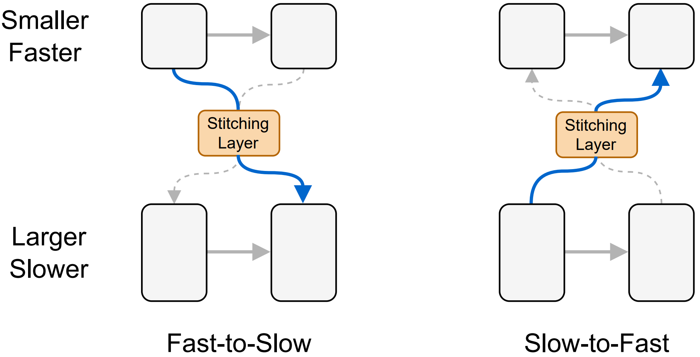
Stitching Method
Where to stitch: Given anchors with different scales and complexities, there are two options to stitch them together: Fast-to-Slow and Slow-to-Fast.
Fast-to-Slow is more aligned with the existing model design principle (i.e., increasing the network width as it goes deeper)
Nearest stitching by limiting the stitching between two anchors of the nearest model complexity/performance
Pan Z, Cai J, Zhuang B. Stitchable Neural Networks[C]//Proceedings of the IEEE/CVF Conference on Computer Vision and Pattern Recognition. 2023: 16102-16112.
https://snnet.github.io/
Notes:
接下来是缝合位置的选择。由于不同锚点的规模和复杂度不同，因此存在两种缝合方向： 从快到慢和从慢到快。从快到慢是指从小规模的模型缝合到大规模的模型，从慢到快就是从大规模模型缝合到小规模模型。作者认为从快到慢更符合现有的模型设计原则（现有的设计原则往往随着网络的深入而增加网络宽度）。除了由快到慢外，作者还提出了最近缝合原则，应该选择两个锚点的复杂度、性能最接近的位置进行缝合。

Slide 14
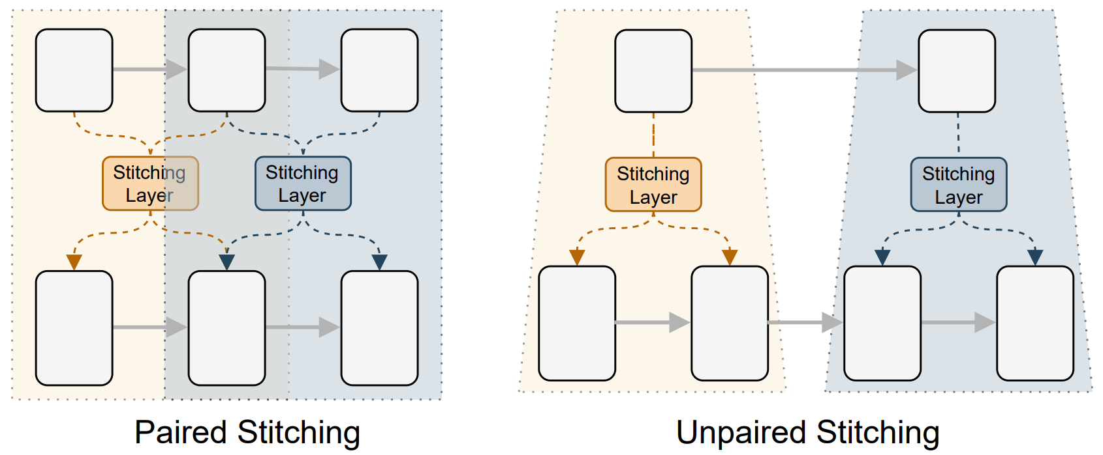
Stitching Method
Way to stitch: Stitching anchors as sliding windows, where the same window shares a common stitching layer.
(neighboring layers dealing with the same scale feature maps share similar representations)
Paired stitching: The depths of two anchor points are the same
Unpaired stitching: The depths of two anchor points are different
Pan Z, Cai J, Zhuang B. Stitchable Neural Networks[C]//Proceedings of the IEEE/CVF Conference on Computer Vision and Pattern Recognition. 2023: 16102-16112.
https://snnet.github.io/
Notes:
接下来是缝合方式，一般而言，处理相同尺度特征图的相邻层的表示是相似的。因此作者将锚点作为滑动窗口进行缝合。这种策略下，缝合两个锚点时会遇到两种情况：配对缝合（L1 = L2）和非配对缝合（L1 ̸= L2）。然而，大多数情况下，锚点深度不等。即使如此，L1层和L2层的匹配可以通过临近插值完成，其中较浅的锚点的每个层可以与较深的锚点的一个以上的层进行缝合，如图5右图所示。

Slide 15
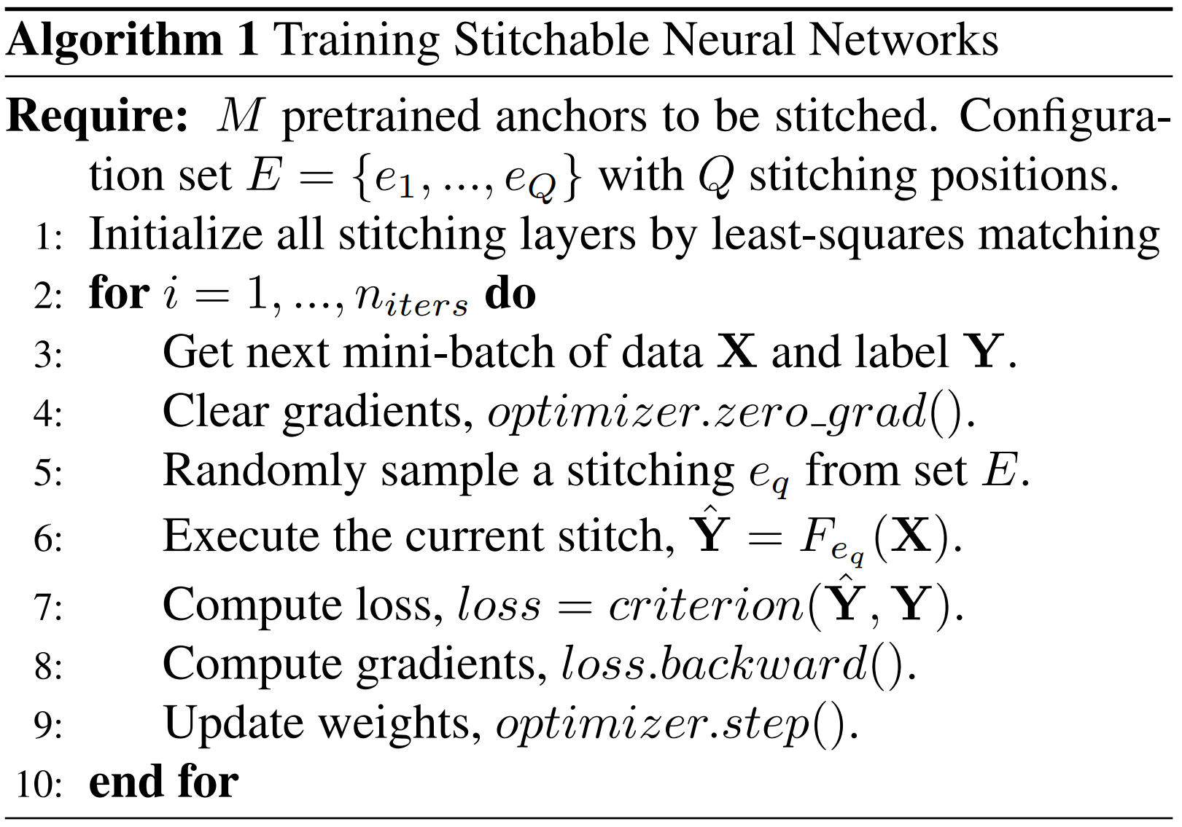
Stitching Method
Training strategy: Efficiently train an elastic joint network that covers a large number of stitches in a highly efficient way so that it can fit diverse resource constraints with low energy cost
Knowledge distillation using RegNetY-160 as the teacher model
The overall training process requires only a few epochs
There is no significant interference between stitches
Pan Z, Cai J, Zhuang B. Stitchable Neural Networks[C]//Proceedings of the IEEE/CVF Conference on Computer Vision and Pattern Recognition. 2023: 16102-16112.
https://snnet.github.io/
Notes:
下面是缝合网络的训练策略。缝合后模型需要进行微调才能获得稳定的性能。训练的目标是得到一个弹性的联合网络来覆盖大量的缝合网络，从而以较低的成本适应多样化的资源约束。这里给出了训练算法的伪代码，首先定义一个包含所有可能缝合的配置集，通过求解前述的最小二乘法匹配来初始化所有缝合层。接下来，在每次训练迭代中，随机抽取一个缝合路径，然后进行常规的监督学习。为了进一步提高缝合的性能，我们还将RegNetY-160为教师模型，进行知识蒸馏。整个训练过程在ImageNet上只需要少量的几个epochs，训练开销远远低于NAS和其他的从头开始训练网络的技术。并且，由于用于缝合的锚点已经训练有素，后面的实验结果显示缝合模型之间不会出现明显的干扰。

Slide 16
Contents
Background and Challenges
Proposed Method
Experimental Results
Pan Z, Cai J, Zhuang B. Stitchable Neural Networks[C]//Proceedings of the IEEE/CVF Conference on Computer Vision and Pattern Recognition. 2023: 16102-16112.
https://snnet.github.io/

Slide 17
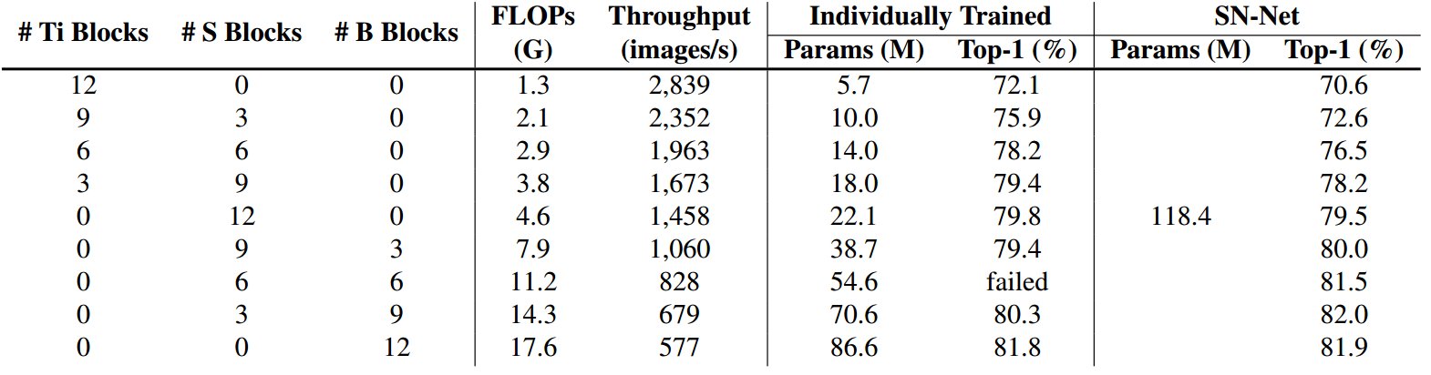
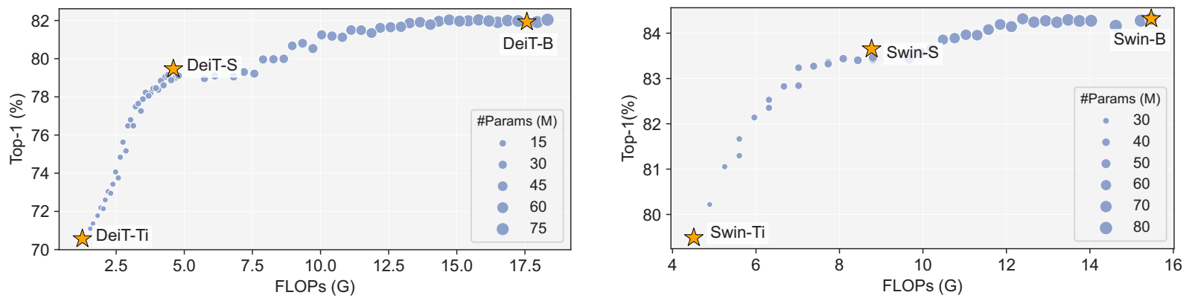
Experimental Results
Anchors: DeiT, Swin Transformer and ResNet.
Performance comparisons between individually trained models from scratch and stitches selected from SN-Net
Performance of SN-Net by stitching DeiT-Ti/S/B and Swin-Ti/S/B
Reduce training costs (71×300 epochs vs. 3×300+50 epochs) and disk storage (2,630M vs. 118M)
Pan Z, Cai J, Zhuang B. Stitchable Neural Networks[C]//Proceedings of the IEEE/CVF Conference on Computer Vision and Pattern Recognition. 2023: 16102-16112.
https://snnet.github.io/

Slide 18
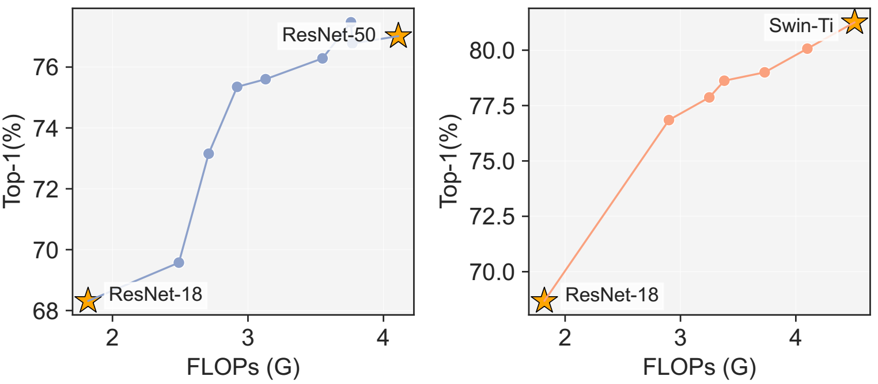
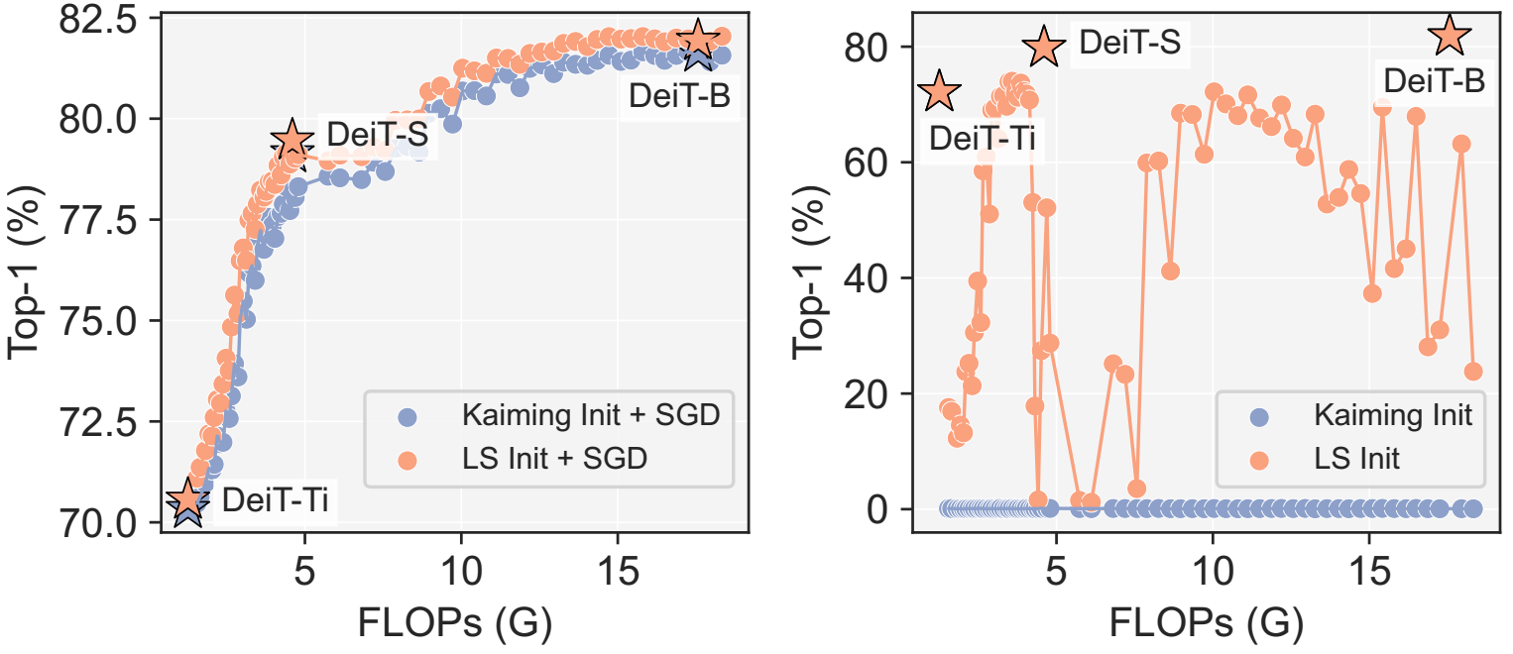
Experimental Results
Effect of stitching CNNs and CNN-ViT
Different learning strategies for stitching layers
Pan Z, Cai J, Zhuang B. Stitchable Neural Networks[C]//Proceedings of the IEEE/CVF Conference on Computer Vision and Pattern Recognition. 2023: 16102-16112.
https://snnet.github.io/

Slide 19
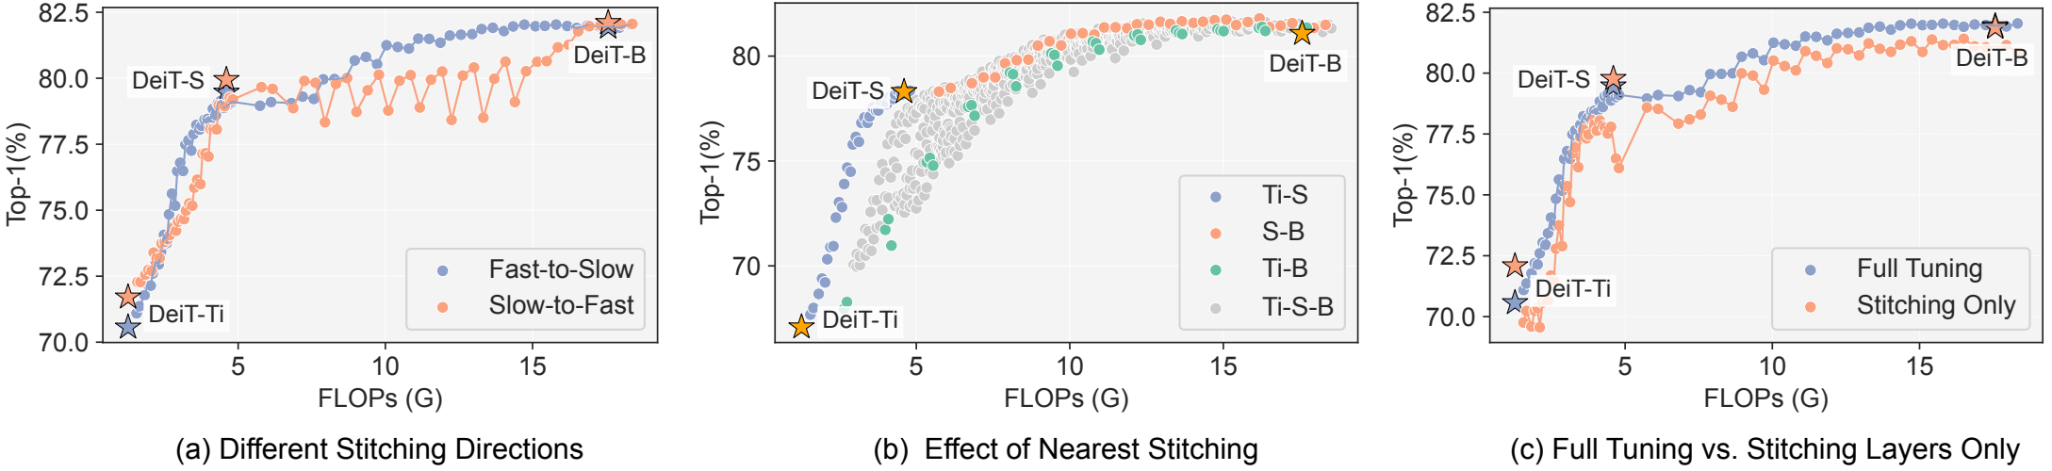
Experimental Results
Pan Z, Cai J, Zhuang B. Stitchable Neural Networks[C]//Proceedings of the IEEE/CVF Conference on Computer Vision and Pattern Recognition. 2023: 16102-16112.
https://snnet.github.io/

Slide 20
Thanks for listening!
Pan Z, Cai J, Zhuang B. Stitchable Neural Networks[C]//Proceedings of the IEEE/CVF Conference on Computer Vision and Pattern Recognition. 2023: 16102-16112.
https://snnet.github.io/

